Slide 1
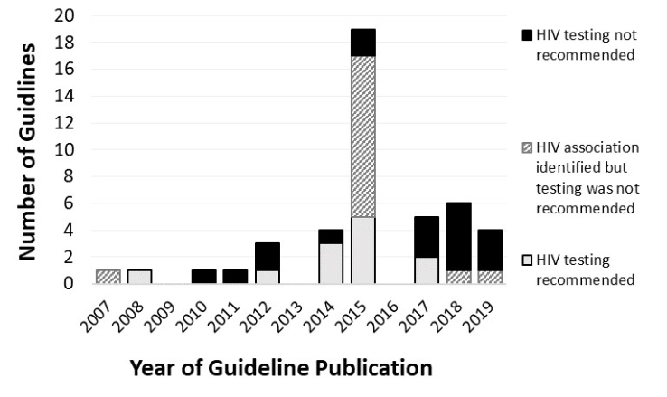
Assessment of HIV testing recommendations in Greek specialty guidelines: A missed opportunity and room for improvement for recommending testing
Karolina Akinosoglou^{1†}, Evangellia-Georgia Kostaki^{2†}, Dimitrios Paraskevis² & Charalambos Gogos¹
¹ University Hospital of Patras, Dept of Internal Medicine and Infectious Diseases ² National and Kapodistrian University of Athens, Medical School, Department of Hygiene, Epidemiology and Medical Statistics, †These authors equally contributed to this work
Introduction
HIV testing for individuals presenting with indicator conditions (ICs) including AIDS-defining conditions (ADCs) is explicitly recommended by European guidelines. We aimed to review specialty guidelines in Greece and assess if HIV was discussed and testing recommended
Table 1. Recommendation for HIV testing and reporting of association with HIV, stratified by type of guideline
 | Number of guidelines identified n (% of total) | GR guidelines where HIV testing is recommended n (%) | GR guidelines where association with HIV reported but not advise testing n (%) | GR guidelines where HIV is not mentioned n (%)
All Guidelines | 47 (100) | 12 (26) | 15 (32) | 20 (42)
AIDS-defining conditions (ADC) | 11 (23) | 2 (18) | 7 (64) | 2 (18)
Indicator conditions (IC) | 36 (77) | 10 (28) | 8 (22) | 18 (50)
Source of guideline
Specialty society guidelines | 41 (87) | 11 (27) | 14 (34) | 16 (39)
National Public Health Organization /Ministry of Health | 6 (13) | 1 (17) | 1 (17) | 4 (66)
Specialty HIV indicator conditions | Number of guidelines identified n (% of total IC per specialty) | GR guidelines where HIV testing is recommended n (%) | GR guidelines where association with HIV reported but not advise testing n (%) | GR guidelines where HIV is not mentioned n (%)
Respiratory | 2 (67) | 1 (50) | 0 (0) | 1 (50)
Neurology | 7 (70) | 3 (43) | 0 (0) | 4 (57)
Gastrointestinal | 6 (63) | 2 (33) | 1 (17) | 3 (50)
Oncology | 6 (75) | 0 (0) | 1 (17) | 5 (83)
Haematology | 2 (67) | 1 (50) | 0 (0) | 1 (50)
Infectious Diseases | 9 (90) | 2 (22) | 5 (56) | 2 (22)
Renal | 1 (100) | 0 (0) | 0 (0) | 1 (100)
Ophthalmology | 0 (0) | 0 (0) | 0 (0) | 0 (0)
Dermatology | 2 (67) | 0 (0) | 1 (50) | 1 (50)
Dental/Ear Nose Throat | 0 (0) | 0 (0) | 0 (0) | 0 (0)
Rheumatology | 0 (0) | 0 (0) | 0 (0) | 0 (0)
Obstetrics and Gynaecology | 1 (100) | 1 (100) | 0 (0) | 0 (0)
Methods
We reviewed European HIV testing guidelines to produce a list of 25 ADCs and 48 ICs. Websites of specialist societies, the National Public Health Organization / Ministry of Health, and Google searches were utilized to identify Greek guidelines for these conditions
Results
We identified guidelines for 11 of 25 (44%) ADCs and 30 of 48 (63%) ICs. Fourteen out of 25 ADCs and 18 of ICs had no Greek guidelines available. In total, 47 guidelines were reviewed (range 1–6 per condition); 11 (23%) for ADCs and 36 (77%) for ICs. Association with HIV was discussed in 7 of 11 (64%) ADC and 8 of 36 IC guidelines (22%), whereas HIV testing was appropriately recommended in two of 11 ADC (18%) and 10 of 36 IC guidelines (28%). Significant differences were found for the distribution of recommendation to test in both types of condition (ADCs or ICs), with ICs having higher percentage of non-recommendation (50%, p<0.05).There was no association between source of guideline or year of publication and recommendation to test (p=0.54 and p=0.07, respectively).
Conclusion
The majority of guidelines for ICs and ADs do not recommend testing. Specialists managing most ICs and ADCs may be unaware of the actual prevalence of undiagnosed HIV infection among their patients, or the respective recommendations produced by HIV societies.
PRESENTED AT THE 23RD INTERNATIONAL AIDS CONFERENCE (AIDS 2020) | 6-10 JULY 2020

